Slide 1
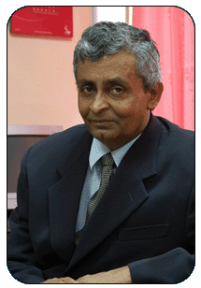
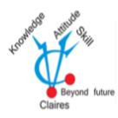
Information Technology (IT) and its impact on the Church and Society
PROGRAMME OF ON-GOING FORMATION FOR PRIESTS ORDAINED BETWEEN 1994 & 1998 Ampitiya National Seminary Kandy Sri Lanka
27th July 2011
Christie Alwis BSc (Eng) Hons (SL), MIET , C. Eng (Lond), FIESL (SL), MICE (SL)
Visiting lecturer in communication to university of Sri Lanka Moratuwa & Sabaragamuwa Former Chief Network officer SLT
Consulting Engineer

Slide 2
About Christie Alwis, www.christiealwis.com 0777748444, christie@christiealwis.com
Christie Alwis, is a professional engineer, who has worked in telecom industry for more than 33 years, both in Srilanka & abroad. Currently he is a visiting lecturer for Communication & Computer Engineering to Universities of Moratuwa & Sabaragamuwa. He is the Chairman of Claire Information (Pvt) Ltd, a company specialized in computer related activities such as web, software development & ICT training. He has developed many school web sites, specializing to disseminate Catholism thro the modern technology.
To study the religion in sinhala, he has developed a web www.sinhalagospel.com , to enjoy religion thro Holy Mary, he has develop www.whymary.net,To propagate Holy Mary thro Madhu church he has develop www.ourladyofmadhusrilanka.com . He has conducted confirmation classes
He has pilgrim more than 25 annual visits from Srilanka to Lourdes. In gratitude for this now he is compiling a book 'Life with Holy Mary/ What I learned in Lourdes out of lighting candles' which he hope to publish soon. He has develop a educational pamphlet to be distributed at Madhu church, a novel approach to reach happiness through our religion.

Slide 3
Nature of Life
God is Dynamic
Every day He changes the life of the people
Resulting the change of living his own creation the Human Being
We experience many revolutions
Agriculture
Printing
Industrial
Past
Communication
Present
What next ?
Transportation Revolution
Energy Revolution
Future

Slide 4
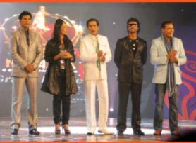
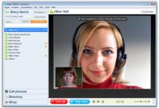
What we see today
What are the communication types we experience ?
Public and personal recent changes
Public from newspapers, books, radio to internet, TV
Personal from letters, fixed telephones to e mail and mobile telephones
Major revolution using one terminal a big TV screen at home for public & personal communication, one mobile terminal for personal (like black berry) to be used to store all your data, and be able to communicate with public and personal both
Hybrid Communication, now used mainly for entertainment (Mega shows)and will push further for education and religion What next, Today triple play will include the smell
Further research on identifying terrorists

Slide 5
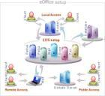
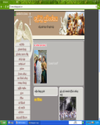
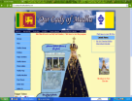
Next generation Communication network is now on the way
Immediate future you will see the following.
e-office, e-Learning, e-Medicine, e-Security, e-Government, e-banking…
What Next?
Can we practice the major activities without
going to the church? E confession ..is it possible?
e-religion
Are we Prepared?
www.sinhalagospel.com, www.ourladyofmadhusrilanka.com www.whymary.net,
www.archdioceseofcolombo.com, www.vatican.va

Slide 6
The out come of any revolutions
What is God’s Plan?
Improving the efficiency resulting in improving the effectiveness & productivity
What is efficiency?
Efficiency = The resources needed to do a job according to your mindset
Actual resources we used according to present technology
If you’re mindset is for bullock cart instead of motor cars
3hours
2 weeks for from Colombo to Ampitiya
24hours x 14
3hours
3 hours for from Colombo to Ampitiya
3 hours
You’re more than 100 times inefficient than current day technology.
If you’re mindset is for postal instead of emails
5 seconds
5 days for from Colombo to Ampitiya
5 days x 24hours x 60 min x 60 seconds
5 seconds for from Colombo to Ampitiya
You’re more than 86000 times inefficient than current day technology.
Today computer works not to a second but for pico seconds.
Pico means what? Pico means divided into million and against divided into million. But human
Cannot work even for hours. There is a big gap between technology and human.
With the Revolutions, your inefficiency will be increased exponentially
if your mindset is not for the current technology
What is 'Christianity Teaching on this aspect?

Slide 7
How to develop free thinking?
Is human an animal? Human does action for a purpose. But animal does action without any purpose.
Can Human become an animal during this lifetime? Or Can animal become human during this lifetime?
Animal is never become a human during this life. But human can become an animal during this lifetime if he does things for a bad purpose
What are the difference between religious law and government law?
Individual person identify his own sins and correct himself individually to nullify the bad effect of sins according to the religious principles. According to the government principles, the third party will identify whether he has against the law. If so punishment is enforce. Hence religious law supersedes government law to convert to a happy people
If he is not happy and if he does not use (not to know) the latest development in the world, can he enjoy his life?
To develop as a free thinker he should be happy person and be efficient, productive and effective using the technological advancement make up to that date in the world.
How Christianity supports to develop as free thinkers? Your mother cannot decide whether you were a girl or boy. You cannot decide from which parents to be born. Christian believes God has decided through your parent to bring you into this world in same image as God. / You will never go for a advice from a crying person how to be happy. Always we go to God when you are unhappy to ask for happiness. Hence God is a happy person. If our farther is happy we should live the life happily in this world. If we are unhappy we should verify why is it so?
Can Christian live as a unhappy person in this life? Definitely NO
How a catholic, while he is being happy contribute to the society to make the others happy?
Living beings in the world needs five basic elements. Earth, Water, Food, Sunlight and Air . Human needs one more. Fire. For a human all these elements are not continuously needed except air. Air is invisible. It will be taken to your lungs through your nose. Catholic tends to believe that air is God, nose is Holy Mary and lungs is You. When you inhale you inhale happiness and hope from God through Holy Mary to you. The motto is “Don’t be afraid” from God through Holy Mary to you. When you de-breath your sorrows and fears will be handed over through Holy Mary to God. Motto will be “Totally Yours”. (Since you don’t know your fears and sorrows are according to your thinking pattern.) Hence you can be happy anytime if you follow the catholic principle.
How Christianity provide to convert your inborn talents to energy? You can be happy. But if you don’t convert your talents as energy to the society you become either inactive or reactive person. With Christianity to enjoy the life you have to be dynamic like a waterfall. In order to be dynamic, you should develop your inborn talent with the latest technology to convert your talents to energy and to become a proactive person.

Slide 8
Are Sri Lankans Proactive People?
1505 - Portuguese
1650 - Dutch
1815 - British
1948 – We got independence
1950 - Our GDP was better than Singapore & India
1960 – Our GDP was comparable to Singapore and better than India (SL GDP US$1300, Singapore US$ 2310)
1977 – Our GDP was very much lower than Singapore & Korea (Singapore US$ 9058, Sri Lanka US$ 1500)
Have We thought proactively to use modern technological advancement into our country?
After
Aero plan
NO

Slide 9
How you can convert your talents to energy..
St. Jane de chantal( 1572 - 1641) 'Hell is filled with people who were Talented, but heaven holds those who were Energetic!. ' Gods will be done today, tomorrow and forever without any "If" and "But“.
First you should be happy. The religion will tell you how to be happy. Then you should be efficient. The present day technology will tell you how you can use your happy life in efficient way to maximize your happiness and make the others happy. Then you become a proactive person. Otherwise you will be inactive or reactive.
Will Christianity tells you what to do?
1. What Gospel says about new technology
Neither do people put new wine into old wineskins, or else the skins would burst, and the wine be spilled, and the skins ruined. Matthew (9:14-17)
2. What gospel says if you are not following the New technology?
No man having drunk old wine immediately desires new, for he says, 'The old is better. Luke (5: 38-39)
3. Multiplication of Loves
If you trust God and carryout actions you can see miracles similar to Multiplication of loves. Ex: MADD (Mothers against Drunken Drivers), Nelson Mandala, Mother Teresa, Little flower of Jesus St. Therese.
Basic factor needs to catholic to be happy.
Ten commander under the umbrella of pardoning and forgetting. (Catholic believes every human beings tend to sin from Adam and Eve. Hence I am weak, You are weak. If I see weakness of you, I should forgive and forget your sin, since I also prune to sin. This is what Jesus taught during his 3 years of public life.)
Catholic can make this country better than now according to their religion. But

Slide 10
What Sri Lankan experienced?
Cheating
BLIND worship
towards others
Unnecessary Judging

Slide 11
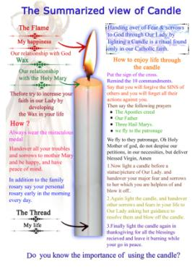
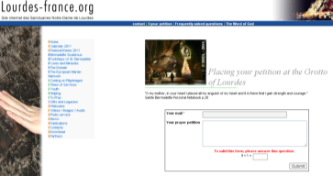
How to enjoy our life through Catholism?
When we live in this world we develop interdependency. This will lead to enjoy happiness through
hope or suffer (sorrow) leading to fear. Our religion consists of four major pillars. Our beliefs (The creed), Our Worship to God (Seven Sacrament), How we behave as catholic (Ten Commandments with Pardoning and Forgetting), How we establish connection with God (Our Father/Holy Mary/Saints). Catholism gives very simple practical methods to be happy by handing over your fears to Holy Mary by way of lighting candles, offering pettition. (If our catholic knows the correct concept, they will not go to forune tellers, see horoscope, neither refraining from auspicious time which will condition your life unnecessarily.
With the latest technology internet, many catholics (including non catholics) enjoy their life by handing over their fears by internet petition For example you can try www.rainbowinformation.com/maristsa/maryhome.html.
The candle ritual will be very
Attractive in the pilgrimage
How the present technology facilitates Catholics to practice their religion)
How the technology helps Catholics to
enjoy their life through the modern technology.

Slide 12
IT for Sri Lanka Catholic Church…
As Christian what we observe? Jesus Christ has not used sound systems at any of his sermons, neither he did not travel in motor vehicles!. The Christianity clearly shows, the application of latest technology, though Jesus did not facilitate with that kind of technology, to explain the good news of reaching happiness. We have to be Proactive! We experience the negative economical growth of our country due to non proactivenes. May be as catholic we are also responsible for that. Similarly as a religion catholic has to use the latest technology as shown clearly in the gospel. Otherwise our catholics may not be enjoy their life through our religion though our churches are full of people.
How far are we successful in introducing internet to our church or using sms to explain our religion to our catholic.
Catholic TV channel
www.catholictv.com , www.ewtn.com, www.cibtv.com, www.saltandlighttv.org, www.knxt.tv
How to popularize among Catholics..

Slide 13
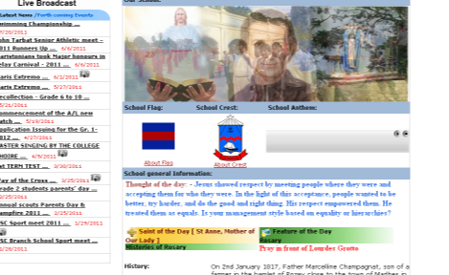
How far Catholic education influenced by IT and Internet.
From certain catholic school website, now you can read the Saint of the day or you can visit
Lourde grotto online. Also student can handover their Fears through their website going to
lourde grotto in petition. Importance religion and sport events are being live broadcasted
through their website.
Latest News
Thought of the day
Saint of the Day
Pray in front of Lourdes Grotto
www.marisstellacollege.net ,www.demazenodcollege.net,www.holycrosscollegegampaha.com,
www.avemariaconvent.com,www.avemariabolawalana.net,www.josephvazcollege.com
Certain schools introduce their welfare system for a better financial management. Certain schools have introduced complete data bank of parents and assign foster teacher to identify the students categories according to their way of the living. Most of the mothers have gone abroad. Some fathers are drunkers. Categorise them and provide the mental treatment is needed in present social system. Ex: Maris School “Sevilla Computer Programme”. Certain catholic schools are managing the teacher attendance and substitute the teachers. Ex: Teacher Robo at Ave Maria Convent, Negombo.
Certain Catholic schools now under way to computerize the students’ daily attendance.
We know if we don’t go for latest technology, we are more than 100,000 times inefficient than
the immediate past technology. Our Religion subscribe to go for new technology.
Can catholic School be a catalyst in Sri Lanka?

Slide 14
Application of IT to the Catholic Church…
Catholic church set to be one of the efficient management system in the world. We
Documented marriages, baptism, death and reception of holy sacrament. In the modern
era , the information can be stored in a very little volume of storage and can be accessible
With various data grouping. So that guidance and support can be extended through
The catholic principle to the needy people. This will make our devotees more confidence
To extend the real happiness which our Heavnly Father given us.
Hence Computerizing the data of each parish with regard to following aspect are of very
Important.
Development with IT for Catholic Church, Sri Lanka
Computerizing data of baptism, marriages, death.
Develop the church website
Online Thanksgiving and Online Petitions
Online Mass broadcasting specially on the feast day.
Online religious education similar to www.sinhalagospel.com
Online hymns broadcasting with triple play. (singing, supporting video,
Lyrics and musical notes)
Disseminate the Holy Word through email and SMS.
The above development are not very cost involve. Every day it is
becoming cheap. May be this seminar will enlighten you how to use.

Slide 15
Conclusion… Why Catholic church has to go for IT and Internet Catholic Church has identified the need to use the latest technology even from Vatican 2
' Inter Mirifica The second vatican council, in a decree on social communications called 'Inter Mirifica', specifically identified the press, cinema, radio, and TV, as means of communication which of their nature can reach and influence not merely single individuals but the very masses and even the whole of human society. It further gives very specific directions for each member of the church - lay people and members of the clergy alike - to participate in spreading the Gospel message of Jesus Christ through the media.
Blessed John Paul 2 last apostolic letter At the 40th anniversary of the paper ' Inter Mirifica‘ 'The Rapid Development' (2005) JP2 spoke about the potential of internet. It says ' New technologies in particular create further opportunities for communication understood as the service to the pastoral government and organisations of the different task of the christian community. One clear example today is how the internet not only provides resources for more information but habituate persons to interactive communication.....Do not be afraid of new technologies! These rank among the marvellous things- Inter Mirifica'- which God has placed at our disposal to discover, to use and to make known the truth, also the truth about our dignity and about our destiny as his children, heirs of his eternal kingdom.'

Slide 16
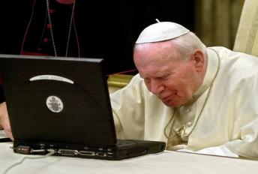
Point of Caution…
Important to know Blessed JP2 may not have understood how these new advances in communication worked, but he certainly saw the potential for their use in evangelization.
.
Similarly don’t be afraid about new technology to be applied to your own pastoral work. Don’t try to study what is happening in the technology. i.e. engineering. But use the technology for our happiness. Don’t refrain of using IT and Internet because of Pornography. Pornography introduce fear for not to use internet. When you think about the vast development that you can reach from internet, the pornography count only less than 0.001%. We should explain and train our catholics how to have self control similar to our religious practices with regard to pornography.
Student has to be told what will happen for them if they use Pornography. (Mental disorder) We should advice parent , not to watch pornography by themselves
God Bless Sri Lanka!

